Slide 1
Implementation of FFT using Divide & Conquer Programming Approach
Amala Thampi (14535003)
Nikita Jain (14535031)
Nishtha Behal (14535032)
Preeti Bansal (14535035)
Yashika Jain (14535054)

Slide 2
Introduction
The Fast Fourier Transform (FFT) is an efficient algorithm to compute the Discrete Fourier Transform (DFT).
FFT computes DFT of N points in Ө(NlogN) operations as compared to Ө(N²) operations performed in conventional method.

Slide 3

Discrete Fourier Transform
In DFT, we have to calculate following polynomial-
of degree-bound n at ω_{n}⁰, ω_{n}¹, ω_{n}² ω_{n}³,..., ω_{n}^{n-1}
where is the principal n^{th} root of unity.
Here, A is given in coefficient form as a = (a_{0,} a_{1,} a_{2, . . .,} a_{n-1}).

Slide 4

Discrete Fourier Transform
The result y_{k}, for k=0,1,...,n-1, by
y_{k} = A(ω_{n}^{k})
= ω_{n}^{kj}
The vector y = (y_{0,} y_{1,...,} y_{n-1}) is the Discrete Fourier Transform(DFT) of the coefficient vector
a = (a_{0,} a_{1,...,} a_{n-1}).

Slide 5
Fast Fourier Transform
The FFT take advantage of twiddle factor. It can compute DFT of N points in Ө(NlogN).
The FFT method employs a divide-and-conquer strategy, using the even-indexed and odd-indexed coefficients of A(x)
A^{[0]}(x) = a₀ + a₂x + a₄x² +. . . + a_{n-2}x^{n/2-1} (even)
A^{[1]}(x) = a₁ + a₃x + a₅x² +. . . + a_{n-1}x^{n/2-1} (odd)

Slide 6
Fast Fourier Transform
So, instead of evaluating A(x) at ω_{n}⁰, ω_{n}¹, ω_{n}²,..., ω_{n}^{n-1}, we can evaluate A^{[0]}(x) and A^{[1]}(x) at
(ω_{n}⁰)²,( ω_{n}¹)², (ω_{n}²)², . . ., (ω_{n}^{n-1})² and then combine the results using
A(x) = A^{[0]}(x²) + xA^{[1]}(x²)

Slide 7
Fast Fourier Transform
Using halving lemma we can say that the points at which A^{[0]}(x) and A^{[1]}(x) are calculated, does not consists of n distinct values but only of n/2 complex (n/2)^{th} roots of unity, with each root occurring exactly twice.
The implemented recursive FFT algorithm computes the DFT of an n-element vector a = (a_{0,} a_{1,. . .,} a_{n-1}), where n is a power of 2.

Slide 8
Fast Fourier Transform
For y₀,y₁,...,y_{n/2-1} we use:
y_{k} = y_{k}^{[0]} + ω_{n}^{k}y_{k}^{[1]}
= A(ω_{n}^{k})
For y_{n/2},y_{n/2+1},...,y_{n-1} we use:
y_{k+(n/2)} = y_{k}^{[0]} - ω_{n}^{k}y_{k}^{[1]}
= A(ω_{n}^{k+(n/2)})
Here we use the property that ω_{n}^{k+(n/2)} = -ω_{n}^{k}

Slide 9
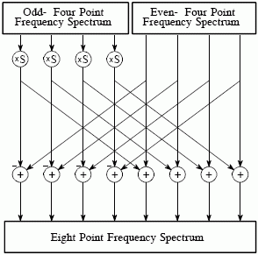
Fast Fourier Transform

Slide 10
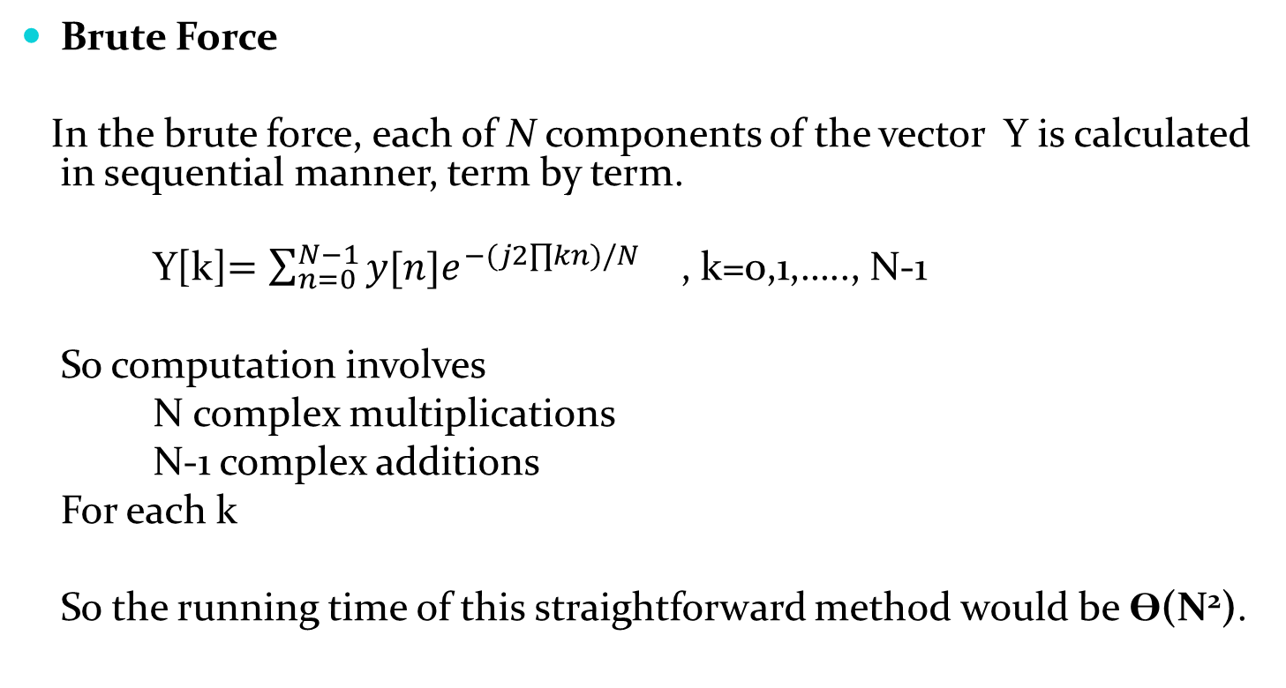
Complexity Analysis
Brute Force
In the brute force, each of N components of the vector Y is calculated in sequential manner, term by term.
Y[k]$=\sum_{n=0}^{N−1}{y[n]e^{−(j2∏kn)/N}}$ , k=0,1,….., N-1
So computation involves
N complex multiplications
N-1 complex additions
For each k
So the running time of this straightforward method would be Ө(N²).

Slide 11
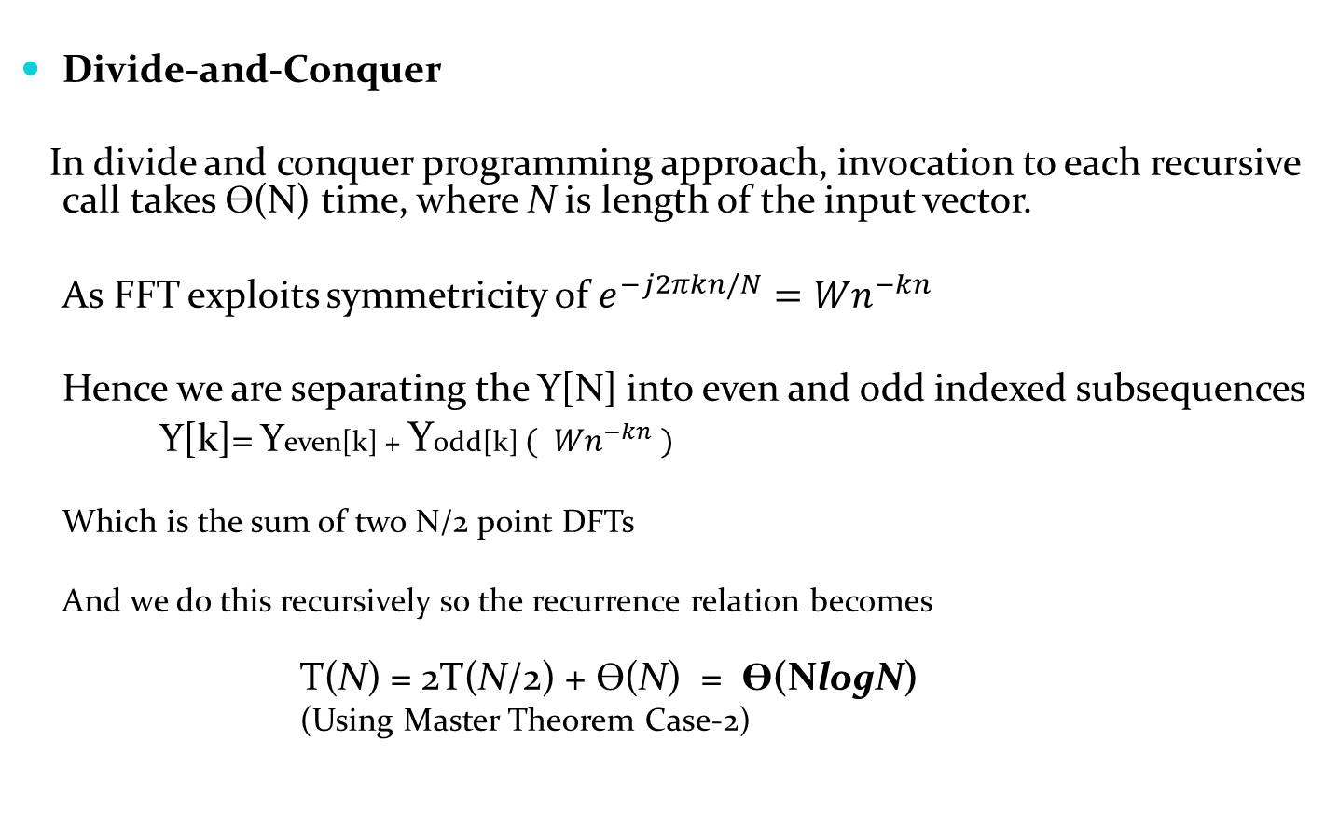
Complexity Analysis (Continued)
Divide-and-Conquer
In divide and conquer programming approach, invocation to each recursive call takes Ө(N) time, where N is length of the input vector.
As FFT exploits symmetricity of $e^{−j2πkn/N}={Wn}^{−kn}$
Hence we are separating the Y[N] into even and odd indexed subsequences
Y[k]= Yeven[k] + Yodd[k] $({ Wn}^{−kn} )$
Which is the sum of two N/2 point DFTs
And we do this recursively so the recurrence relation becomes
T(N) = 2T(N/2) + Ө(N) = Ө(NlogN)
(Using Master Theorem Case-2)

Slide 12
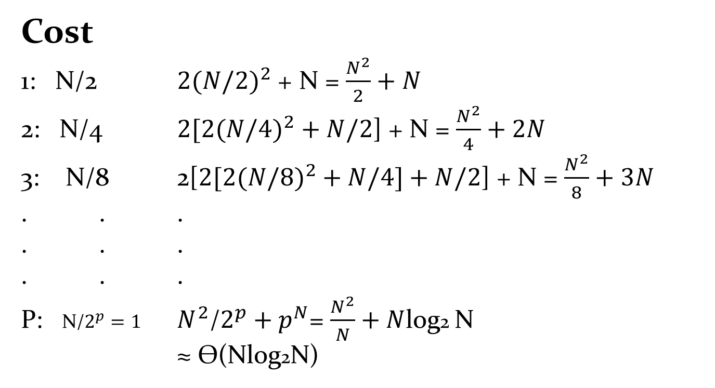
Complexity Analysis (Continued)
Cost
1: N/2 ${2(N/2)}^{2}$ + N = $\frac{N^{2}}{2}+N$
2: N/4 ${2[2(N/4)}^{2}+N/2$] + N = $\frac{N^{2}}{4}+2N$
3: N/8 2[${2[2(N/8)}^{2}+N/4]+N/2$] + N = $\frac{N^{2}}{8}+3N$
. . .
. . .
. . .
P: N/$2^{p}=1$ $N^{2}\text{/}2^{p}+p^{N}$= $\frac{N^{2}}{N}+N$log2 N
≈ Ѳ(Nlog2N)

Slide 13
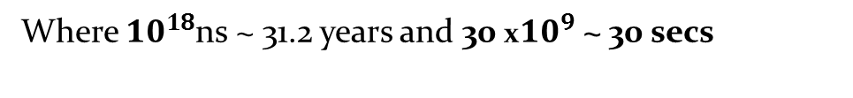
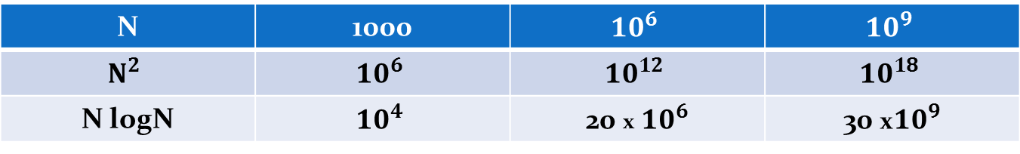
Complexity Analysis (Continued)
N v/s log N
You must be wondering N and log N are almost comparable , then why to take so much
of pain, but when value of N becomes very large it will show drastic effect.
N | 1000 | $${10}^{6}$$ | $${10}^{9}$$
$$N^{2}$$ | $${10}^{6}$$ | $${10}^{12}$$ | $${10}^{18}$$
N logN | $${10}^{4}$$ | 20 x ${10}^{6}$ | 30 x${10}^{9}$
Where ${10}^{18}$ns ~ 31.2 years and 30 x${10}^{9}$ ~ 30 secs

Slide 14
Complexity Analysis (Continued)
Dynamic Programming-
Here the problem cannot be divided in a manner to have overlapping sub-problems. So, we must not apply dynamic programming approach in order to solve the above problem.
Greedy Algorithm-
Greedy algorithms are based on the property that a globally optimal solution can be derived by making locally optimal choices. This problem doesn't relate to this property as we have to compute each value and that too precisely.

Slide 15
Pseudo-code
CAL_MULT(*a, *b)
t->real :=
(a->real*b->real) - (a->imag*b->imag)
t->imag :=
(a->real*b->imag) + (a->imag*b->real)
return t
FFT(coeff, lent)
if(lent = 1)
base->real := coeff[0]
3. base->next := NULL
4. return base
5. coeff_o := lent/2
6. coeff_e := lent-lent/2
7. e = o :=0
8. w->real := 1
9. wn->real := cos(6.28/lent)
10. wn->imag := sin(6.28/lent)
11. for i:=0 to lent-1
12. if(i%2 = 0)
13. coeff_e[e++] := coeff[i]
14. else
15. coeff_o[o++] := coeff[i]
16. y1 := fft(coeff_e, e)
17. y2 := fft(coeff_o, o)
18. k := lent/2

Slide 16
Pseudo-code
while(y1 is not empty)
if(y = NULL and mid = NULL)
y := start1
mid := start2
else
y->next := r
y := y->next
26. mid := mid->next
t := cal_mult(w,y2)
y->real := y1->real + t->real
y->imag := y1->imag + t->imag
30. mid->real := (y1->real) - (t->real)
31. mid->imag := (y1->imag) - (t->imag)
w := cal_mult(w, wn)
y1 := y1->next
y2 := y2->next
y->next := start2
36. return start1

Slide 17
Code Complexity Analysis
The above implementation is done using divide and conquer method.
The FFT() function is called twice with input size of lent/2 resulting in 2T(n/2), as the size of input is divided into two halves every time as coeff_e and coeff_o. Each of length n/2 in each recursion.
The while loop from line 19 to 34 in pseudo-code, takes Ө (n) complexity in each recursion. Hence the recurrence relation time complexity T(n) is
T(n) = 2T(n/2) + Ө(n)
Thus, T(n) = Ө (nlogn)

Slide 18
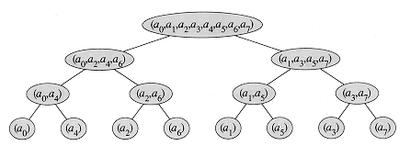
Divide & Conquer approach
Input size N=8

Slide 19
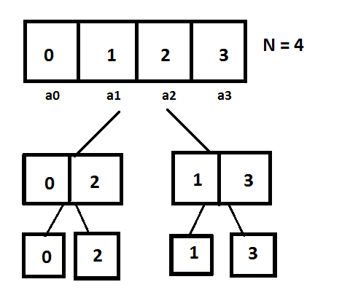
Test Case
y=x + 2 x^2 + 3 x^3

Slide 20
Test Case
y0 = 6 + 0i
y1 = -2.00159 - 2i
y2 = -2 + 0i
y3 = -1.99841 + 2i

Slide 21
Applications
Image Compression
Digital signal processing
Solving partial differential equations
Interpolation
Spectral Analysis

Slide 22
Thank You Any Questions/Suggestions?

